Slide 1
Optimization Framework for Document Categorization
A DSA-Based Framework for Efficient Classification, Searching and Retrieval of Documents
Team Members:
[2510030245-Bonthapally Mamatha]
[2510030073-Nerella Sreeja]
[2510030035-Sriramadasu Anushka]
DATA STRUCTURES AND ALGORITHMS-3 25CS2103E
Under the guidance of
Mr.Aftab Yaseen

Slide 2
Problem Statement & Objective
Problem Statement
Objective
Large document collections are hard to categorize manually
Manual classification is time-consuming
Sequential search becomes slow as documents grow
Documents may contain keywords from multiple categories
Develop a DSA-based framework that automatically categorizes documents and provides efficient searching, indexing and retrieval.
Dataset: 2225 BBC News documents | 5 categories: Business, Entertainment, Politics, Sport, Tech
2

Slide 3
Proposed System & Architecture
BBC News Dataset
Text Processing
Word Extraction
HashSet
(remove duplicates)
HashMap
(category scoring)
→
→
→
→
↓
Searching / Retrieval
Document & Keyword Indexing
Predicted Category
Merge Sort
(rank categories)
←
←
←
System Modules
Dataset → Processing → DSA → Classification → Searching → Evaluation
3

Slide 4
DSA Techniques Used
DSA | Purpose
ArrayList | Store documents and words
HashSet | Remove duplicate words
HashMap | Keyword scoring and indexing
Merge Sort | Rank category scores
Binary Search | Search document IDs
Trie | Keyword and prefix search
Key Point: Each DSA technique is selected for the operation it performs efficiently.
4

Slide 5
Classification & Retrieval
Document Classification
Retrieval
Input Article
HashMap Index
Keyword Index
Text Preprocessing
Document ID → Category
football → [17, 29, 44, ...]
Keyword Matching
Category Scores
Trie
Binary Search
Merge Sort
Exact keyword search and prefix search
Efficient document ID searching
Predicted Category
5

Slide 6
Accuracy & Results
2225
1869
356
84.00%
Total Documents
Correct
Incorrect
Overall Accuracy
Key Observation: Politics achieved the highest accuracy at 94.48%.
6

Slide 7
Confusion Matrix & Error Analysis
Actual / Pred. | Business | Entertainment | Politics | Sport | Tech
Business | 360 | 1 | 127 | 0 | 22
Entertainment | 27 | 320 | 18 | 0 | 21
Politics | 12 | 0 | 394 | 3 | 8
Sport | 13 | 10 | 11 | 462 | 15
Tech | 27 | 20 | 10 | 11 | 333
Main Error
127 Business documents were classified as Politics.
Reason
Keyword-based scoring can overlap when an article has terms from multiple categories.
7

Slide 8
Innovation & Technical Competence
Innovation / Novelty
Technical Competence
Integration of multiple DSA techniques into one document categorization and retrieval framework.
Java + Eclipse + CSV Dataset
Modular packages:
Classification
HashMap indexing
Keyword retrieval
Trie searching
Binary searching
Merge Sort ranking
Performance evaluation
model
processing
dsa
reports
database
ui
8

Slide 9
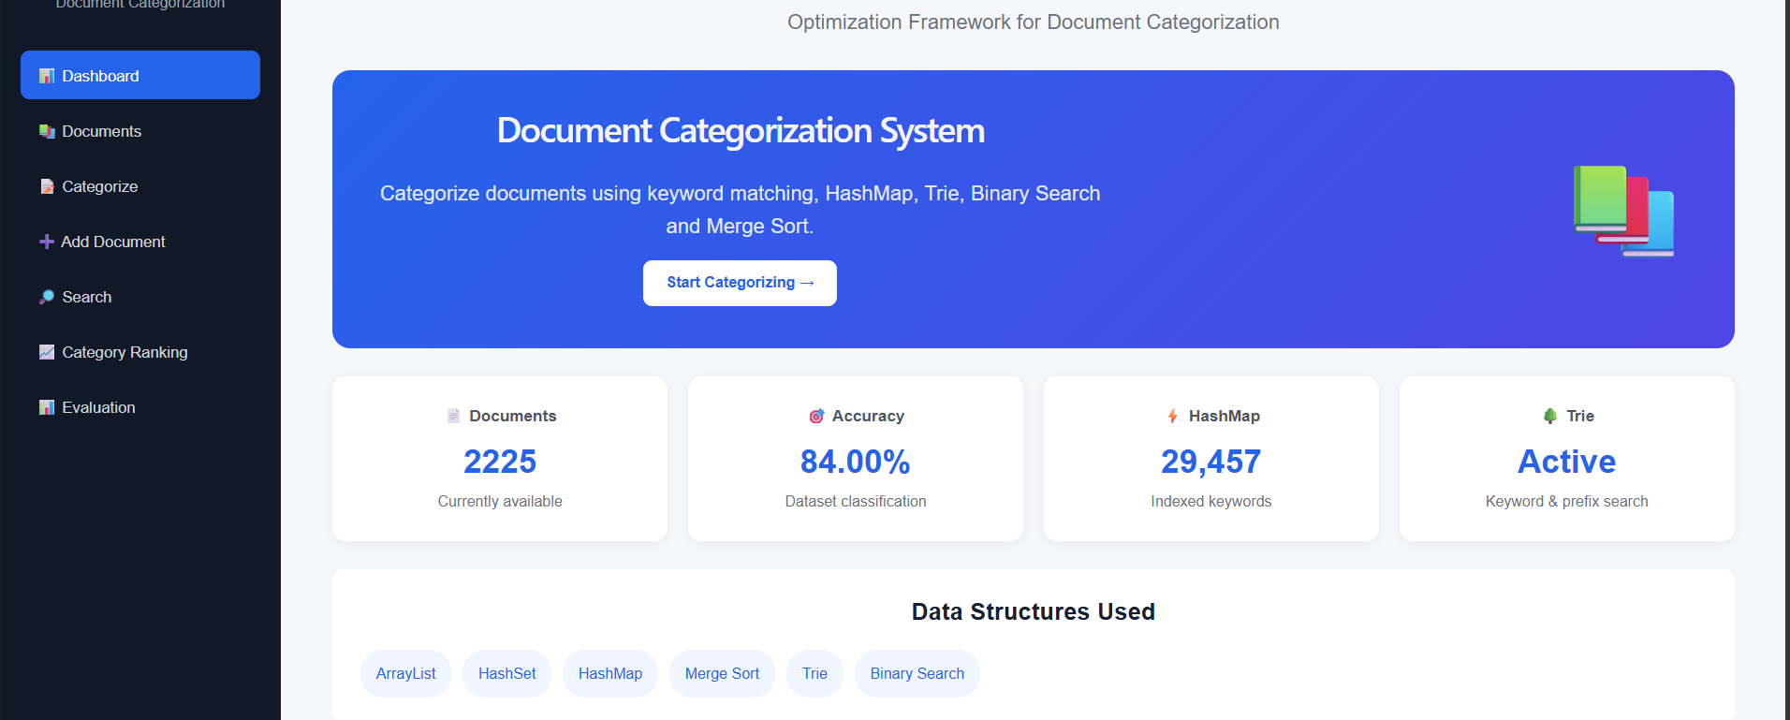
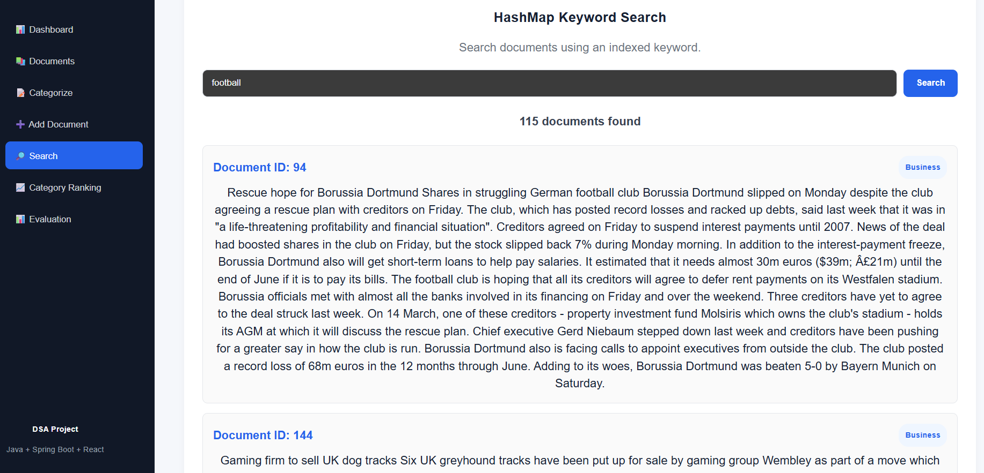
Results:

Slide 10
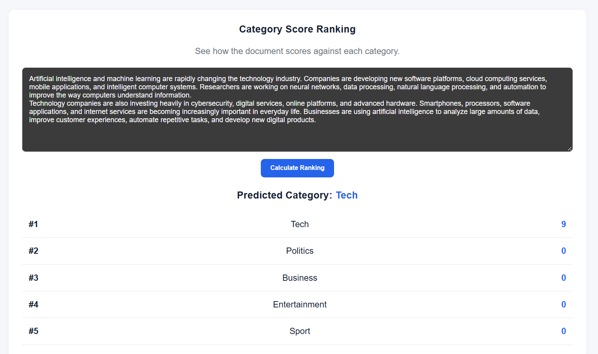
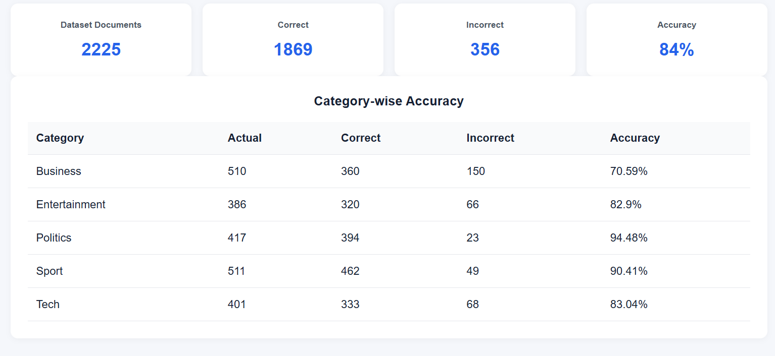
Results:

Slide 11
Performance, Utility & Future Scope
Performance
Utility
Future Scope
Benchmarked HashMap Search vs Binary Search across dataset sizes
Goal: analyze retrieval performance instead of assuming one method is always faster
News websites
Digital libraries
Educational platforms
Research repositories
Document management systems
Weighted keywords
Better text preprocessing
TF-IDF / semantic techniques
Larger datasets
Database-based persistent storage
Improved scalability and retrieval
9

Slide 12
Conclusion
Developed a DSA-based document categorization framework
Processed 2225 documents across 5 categories
Achieved 84% overall classification accuracy
Implemented HashMap, HashSet, ArrayList, Trie, Merge Sort and Binary Search
Provided both classification and efficient document retrieval
Used confusion matrix and benchmarking to evaluate the system
"Our project demonstrates how multiple DSA techniques can be integrated to build an efficient, modular and extensible document categorization and retrieval system."

